Slide 1
Big Data Analytics and Mining
Junming Shao

Slide 2
Lecture 2
Foundations of Data Mining

Slide 3
Ensemble Learning
Criteria: Good performance + Diversity
Strategies:
Bagging
Boosting
Stacking

Slide 4
Rationale for Ensemble Learning
No Free Lunch thm: There is no algorithm that is always the most accurate
Generate a group of base-learners which when combined have higher accuracy
Different learners use different
Algorithms
Parameters
Representations (Modalities)
Training sets
Subproblems

Slide 5
1. Bagging - Aggregate Bootstrapping
Given a standard training set D of size n
For i = 1 .. M
Draw a sample of size n*<n from D uniformly and with replacement
Learn classifier C_{i}
Final classifier is a vote of C₁ .. C_{M}
Increases classifier stability/reduces variance

Slide 6
Random Forest
Ensemble consisting of a bagging of un-pruned decision tree learners with a randomized selection of features at each split.
Grow many trees on datasets sampled from the original dataset with replacement (a bootstrap sample).
Draw K bootstrap samples of a fixed size
Grow a DT, randomly sampling a few attributes/dimensions to split on at each internal node
Average the predictions of the trees for a new query (or take majority vote)

Slide 7
2.Boosting
Train classifiers (e.g. decision trees) in a sequence.
A new classifier should focus on those cases which were incorrectly classified in the last round.
Combine the classifiers by letting them vote on the final prediction (like bagging).
Each classifier is “weak” but the ensemble is “strong.”
AdaBoost is a specific boosting method.

Slide 8
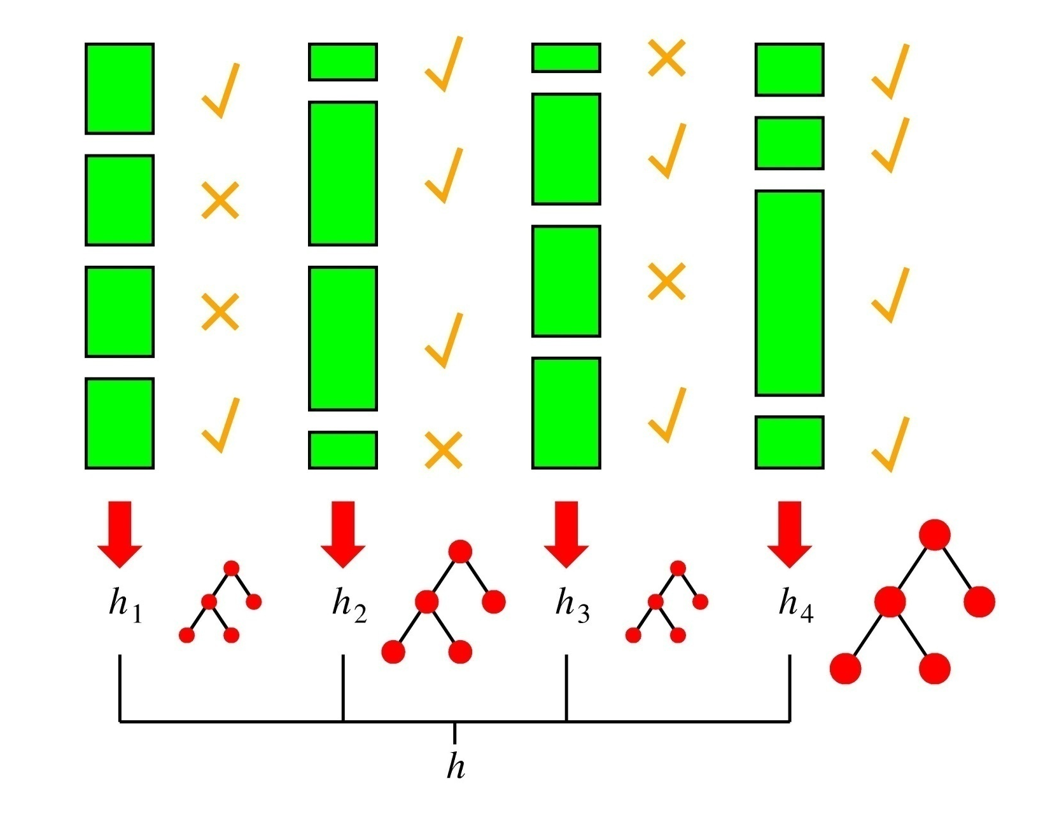
Boosting in a Picture
boosting rounds
training cases
Correctly
classified
This example
has a large weight
in this round
This DT has
a strong vote.

Slide 9
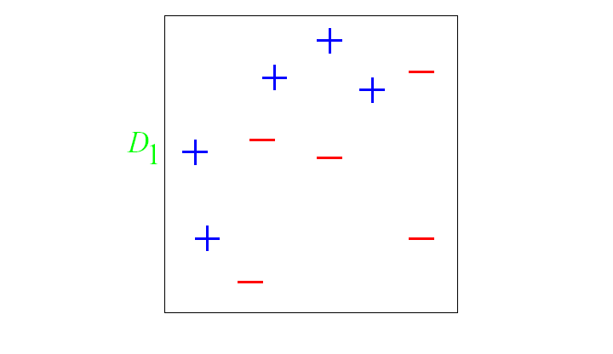
And in animation
Original training set: equal weights to all training samples
Taken from “A Tutorial on Boosting” by Yoav Freund and Rob Schapire

Slide 10
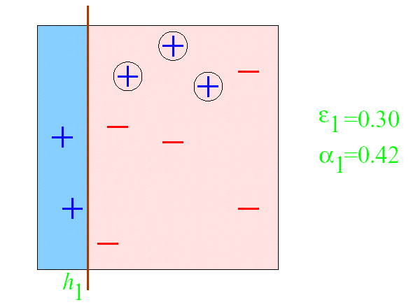
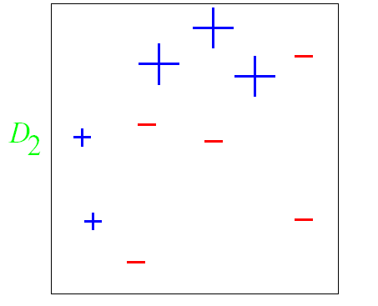
AdaBoost example
ε = error rate of classifier
α = weight of classifier
ROUND 1

Slide 11
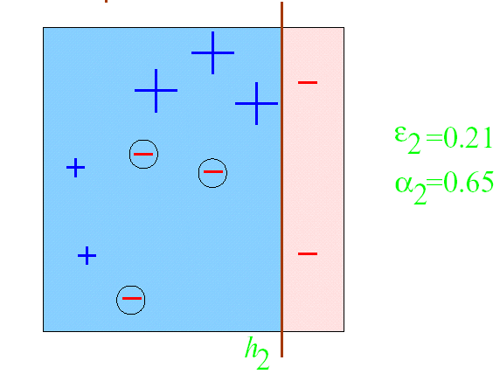
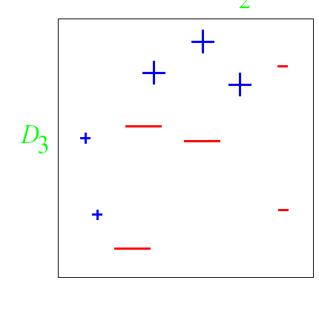
AdaBoost example
ROUND 2

Slide 12
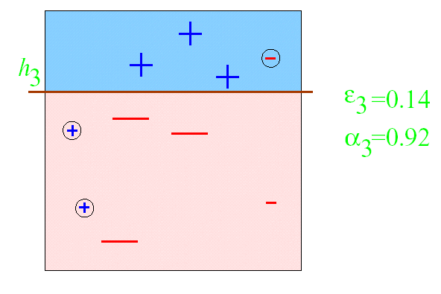
AdaBoost example
ROUND 3

Slide 13
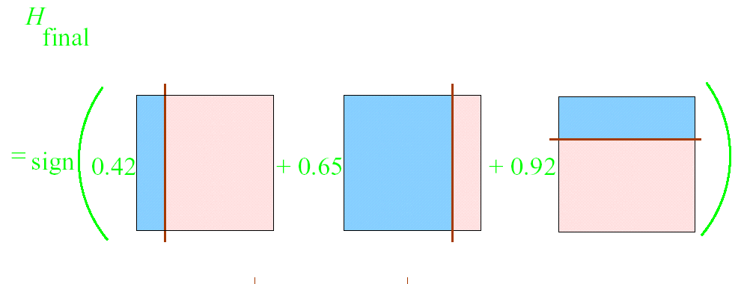
AdaBoost example

Slide 14
Boosting

Slide 15
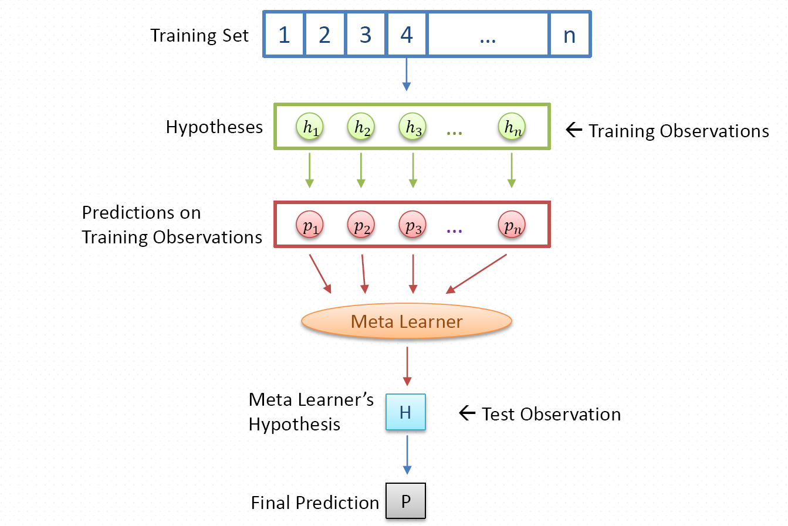
3. Stacking
Framework

Slide 16
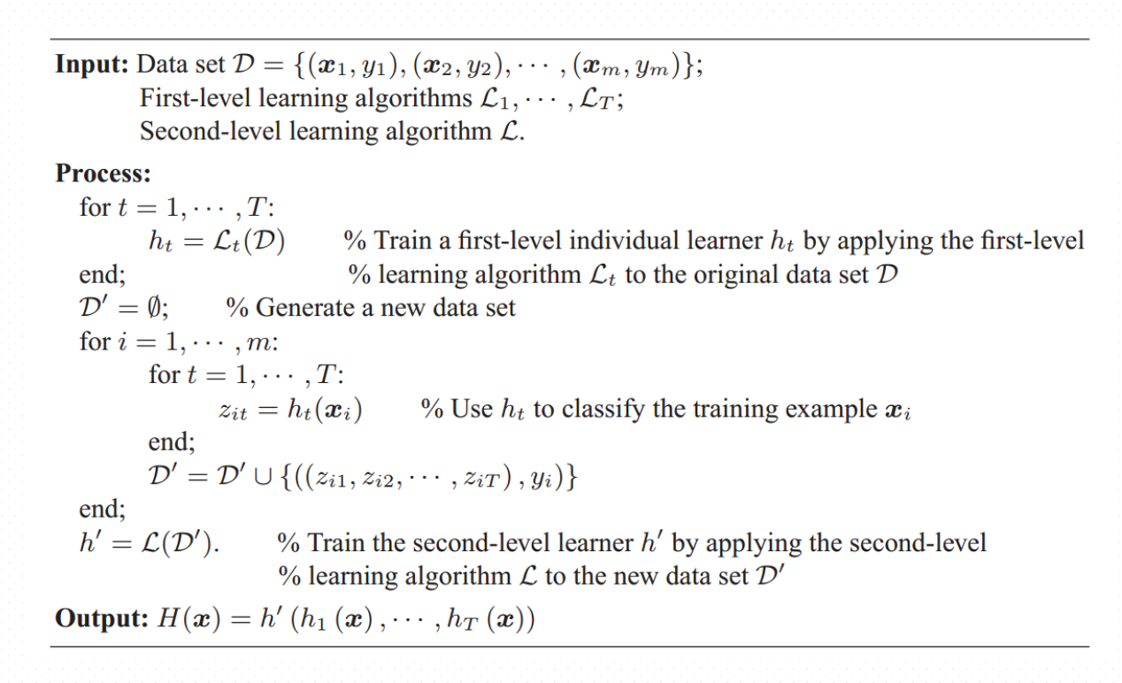
Stacking

Slide 17
Clustering

Slide 18
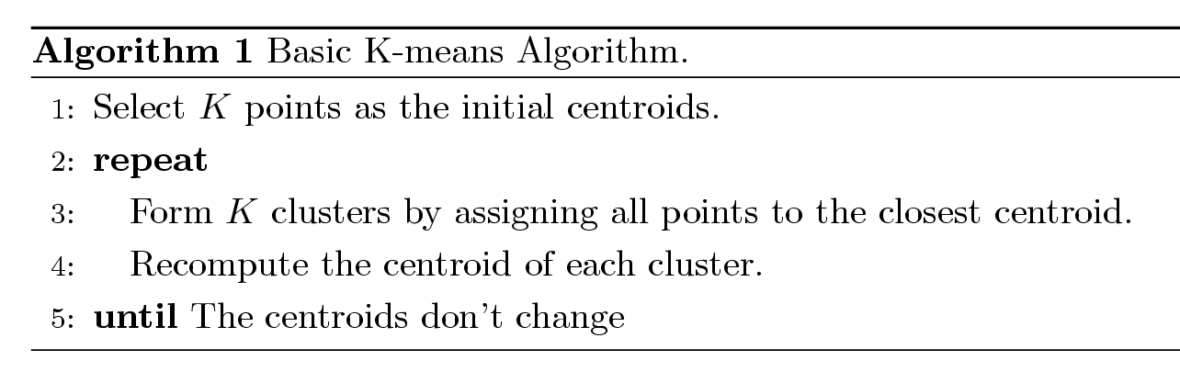
1. K-means Clustering
Partitional clustering approach
Each cluster is associated with a centroid (center point)
Each point is assigned to the cluster with the closest centroid
Number of clusters, K, must be specified
The basic algorithm is very simple

Slide 19
Importance of Choosing Initial Centroids …

Slide 20
Importance of Choosing Initial Centroids …

Slide 21
Solutions to Initial Centroids Problem
Multiple runs
Helps, but probability is not on your side
Sample and use hierarchical clustering to determine initial centroids
Select more than k initial centroids and then select among these initial centroids
Select most widely separated

Slide 22
Evaluating K-means Clusters
Most common measure is Sum of Squared Error (SSE)
For each point, the error is the distance to the nearest cluster
To get SSE, we square these errors and sum them.
x is a data point in cluster C_{i} and m_{i} is the representative point for cluster C_{i} (can show that m_{i} corresponds to the center (mean) of the cluster)
Given two clusters, we can choose the one with the smallest error
One easy way to reduce SSE is to increase K (the number of cluster)
A good clustering with smaller K can have a lower SSE than a poor clustering with higher K

Slide 23
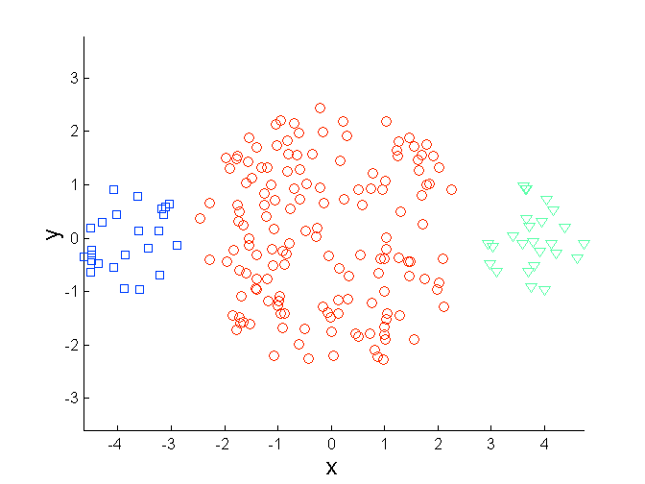
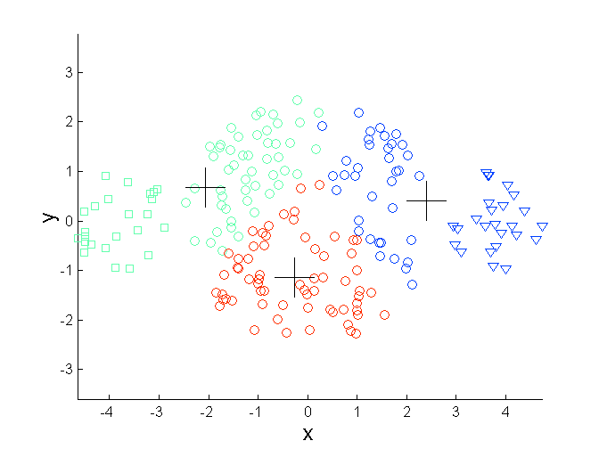
Limitations of K-means: Differing Sizes
Original Points
K-means (3 Clusters)

Slide 24
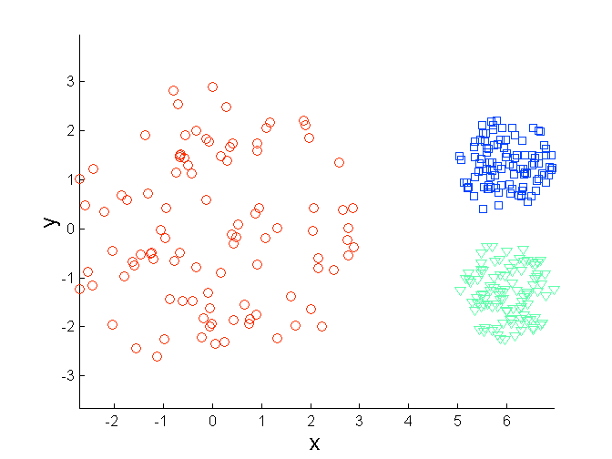
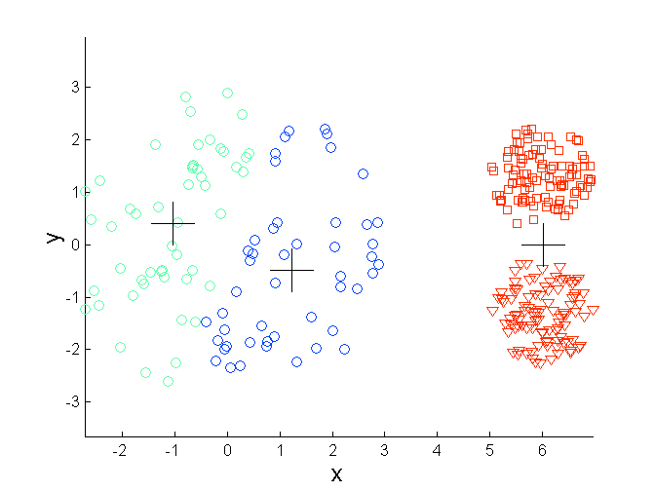
Limitations of K-means: Differing Density
Original Points
K-means (3 Clusters)

Slide 25
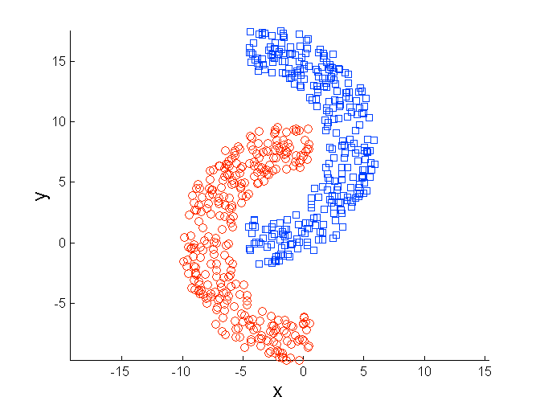
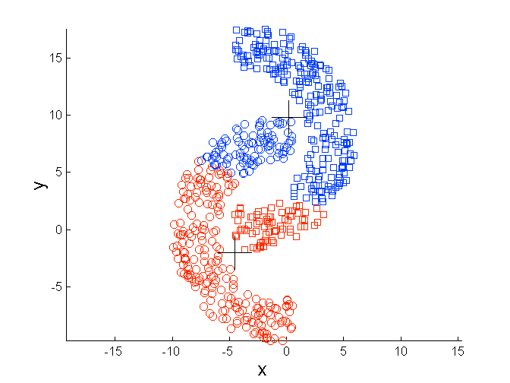
Limitations of K-means: Non-globular Shapes
Original Points
K-means (2 Clusters)

Slide 26
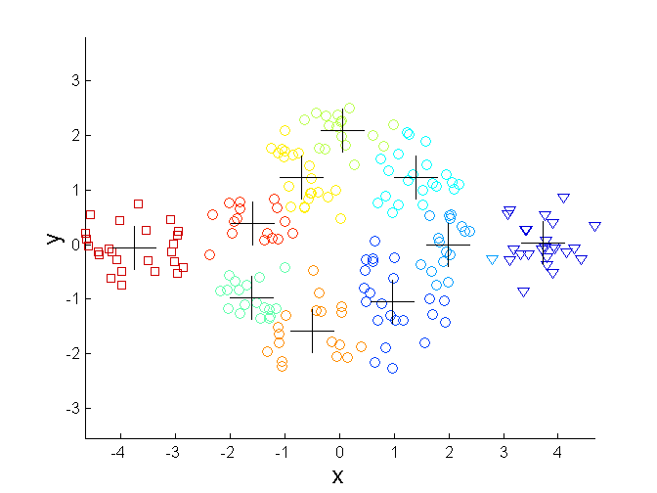
Overcoming K-means Limitations
Original Points K-means Clusters
One solution is to use many clusters.
Find parts of clusters, but need to put together.

Slide 27
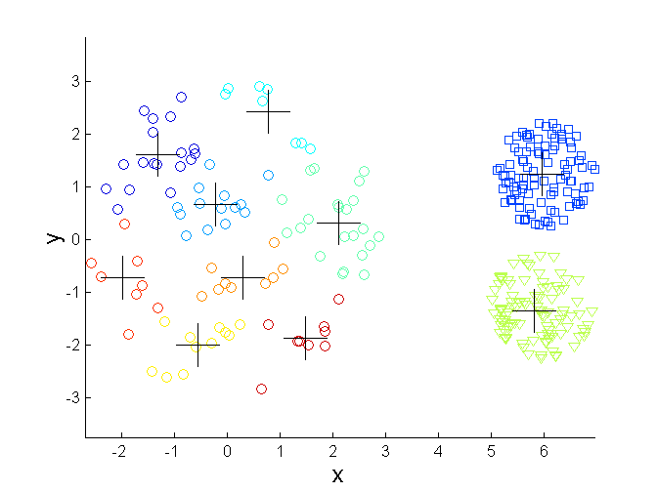
Overcoming K-means Limitations
Original Points K-means Clusters

Slide 28
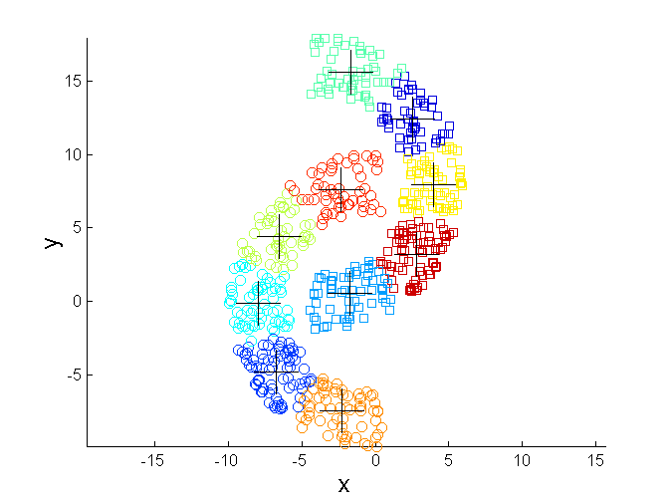
Overcoming K-means Limitations
Original Points K-means Clusters

Slide 29
2. Hierarchical Clustering
Produces a set of nested clusters organized as a hierarchical tree
Can be visualized as a dendrogram
A tree like diagram that records the sequences of merges or splits

Slide 30
Strengths of Hierarchical Clustering
Do not have to assume any particular number of clusters
Any desired number of clusters can be obtained by ‘cutting’ the dendogram at the proper level
They may correspond to meaningful taxonomies
Example in biological sciences
(e.g., animal kingdom, phylogeny reconstruction, …)

Slide 31
Hierarchical Clustering
Two main types of hierarchical clustering
Agglomerative:
Start with the points as individual clusters
At each step, merge the closest pair of clusters until only one cluster (or k clusters) left
Divisive:
Start with one, all-inclusive cluster
At each step, split a cluster until each cluster contains a point (or there are k clusters)
Similarity or distance matrix is crucial!!
Merge or split one cluster at a time

Slide 32
Agglomerative Clustering Algorithm
Basic algorithm
Compute the proximity matrix
Let each data point be a cluster
Repeat
Merge the two closest clusters
Update the proximity matrix
Until only a single cluster remains
Key operation is the computation of the similarity of two clusters
Note: Different approaches to defining the distance between clusters distinguish the different algorithms

Slide 33
Starting Situation
Start with clusters of individual points and a proximity matrix
p1
p2
p3
p4
p5
. . .
p1
p2
p3
p4
p5
.
.
.
Proximity Matrix

Slide 34
Intermediate Situation
After some merging steps, we have some clusters
C1
C2
C3
C4
C5
C1
C2
C3
C3
C4
C4
C5
Proximity Matrix
C1
C2
C5

Slide 35
Intermediate Situation
We want to merge the two closest clusters (C2 and C5) and update the proximity matrix.
C1
C2
C3
C4
C5
C1
C2
C3
C3
C4
C4
C5
Proximity Matrix
C1
C2
C5

Slide 36
After Merging
The question is “How do we update the proximity matrix?”
C2 U C5
C1
C3
C4
C1
?
C2 U C5
? ? ? ?
C3
C3
?
C4
C4
?
Proximity Matrix
C1
C2 U C5

Slide 37
How to Define Inter-Cluster Similarity
p1
p2
p3
p4
p5
. . .
p1
Similarity?
p2
p3
p4
p5
MIN
MAX
Group Average
Distance Between Centroids
Other methods driven by an objective function
Ward’s Method uses squared error
.
.
.
Proximity Matrix

Slide 38
How to Define Inter-Cluster Similarity
p1
p2
p3
p4
p5
. . .
p1
p2
p3
p4
p5
MIN
MAX
Group Average
Distance Between Centroids
Other methods driven by an objective function
Ward’s Method uses squared error
.
.
.
Proximity Matrix

Slide 39
How to Define Inter-Cluster Similarity
p1
p2
p3
p4
p5
. . .
p1
p2
p3
p4
p5
MIN
MAX
Group Average
Distance Between Centroids
Other methods driven by an objective function
Ward’s Method uses squared error
.
.
.
Proximity Matrix

Slide 40
How to Define Inter-Cluster Similarity
p1
p2
p3
p4
p5
. . .
p1
p2
p3
p4
p5
MIN
MAX
Group Average
Distance Between Centroids
Other methods driven by an objective function
Ward’s Method uses squared error
.
.
.
Proximity Matrix

Slide 41
How to Define Inter-Cluster Similarity
p1
p2
p3
p4
p5
. . .
p1
×
×
p2
p3
p4
p5
MIN
MAX
Group Average
Distance Between Centroids
Other methods driven by an objective function
Ward’s Method uses squared error
.
.
.
Proximity Matrix

Slide 42
3. Density-Based Clustering Methods
Clustering based on density (local cluster criterion), such as density-connected points
Major features:
Discover clusters of arbitrary shape
Handle noise
One scan
Need density parameters as termination condition
Several interesting studies:
DBSCAN: Ester, et al. (KDD’96)
OPTICS: Ankerst, et al (SIGMOD’99).
DENCLUE: Hinneburg & D. Keim (KDD’98)
CLIQUE: Agrawal, et al. (SIGMOD’98)

Slide 43
3. Density-based Clustering: DBSCAN
Key concepts
Density = number of points within a specified radius (Eps)
A point is a core point if it has more than a specified number of points (MinPts) within Eps [These are points that are at the interior of a cluster].
A border point has fewer than MinPts within Eps, but is in the neighborhood of a core point
A noise point is any point that is not a core point or a border point.

Slide 44
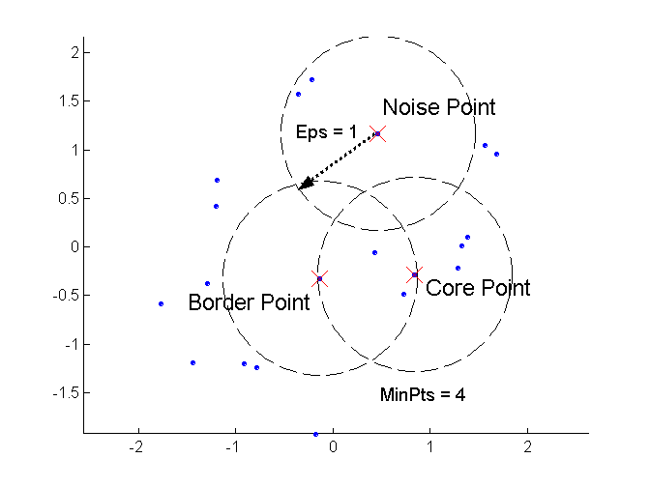
DBSCAN: Core, Border, and Noise Points

Slide 45
Two parameters:
Eps: Maximum radius of the neighbourhood
MinPts: Minimum number of points in an Eps-neighbourhood of that point
N_{Eps}(p): {q belongs to D | dist(p,q) <= Eps}
Directly density-reachable: A point p is directly density-reachable from a point q wrt. Eps, MinPts if
1) p belongs to N_{Eps}(q)
2) core point condition:
|N_{Eps} (q)| >= MinPts
p
MinPts = 5
Eps = 1 cm
q

Slide 46
Density-reachable:
A point p is density-reachable from a point q wrt. Eps, MinPts if there is a chain of points p₁, …, p_{n}, p₁ = q, p_{n} = p such that p_{i+1} is directly density-reachable from p_{i}
Density-connected
A point p is density-connected to a point q wrt. Eps, MinPts if there is a point o such that both, p and q are density-reachable from o wrt. Eps and MinPts.
p
p₁
q
p
q
o
A cluster is defined as a maximal set of density-connected points

Slide 47
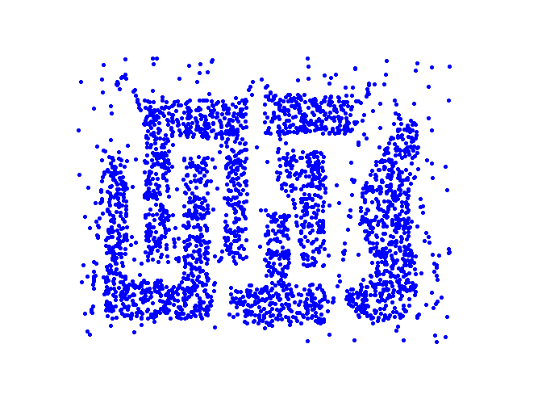
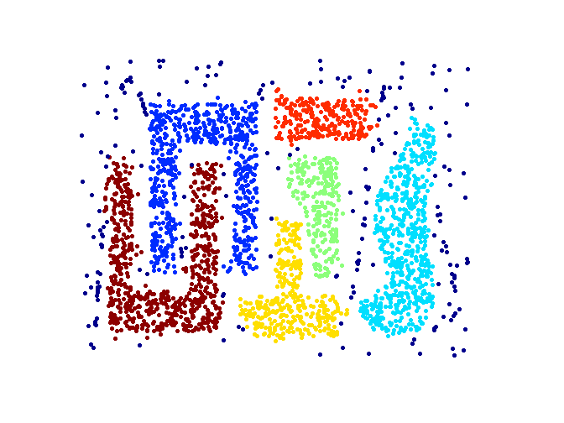
When DBSCAN Works Well
Original Points
Clusters
Robust to Noise
Can handle clusters of different shapes and sizes

Slide 48
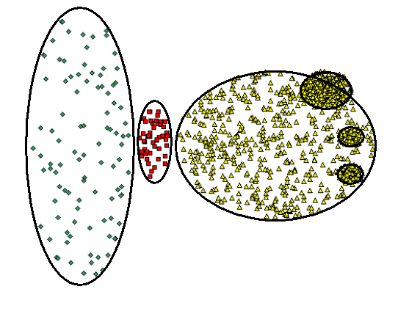
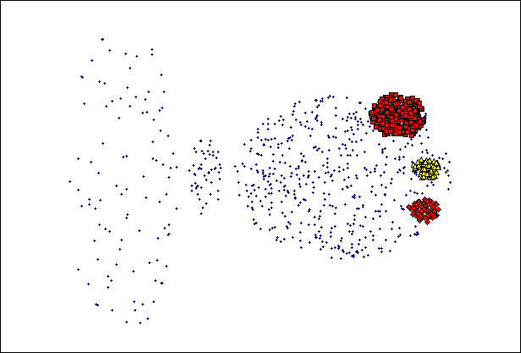
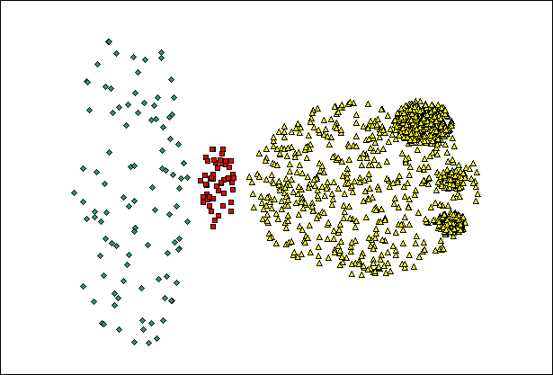
When DBSCAN Does NOT Work Well
(MinPts=4, Eps=9.75).
Original Points
Varying densities
High-dimensional data
(MinPts=4, Eps=9.92)

Slide 49
Thanks !!!

